Slide 1
TDGNet: Hallucination Detection in Diffusion Language Models via Temporal Dynamic Graphs
Arshia Hemmat¹, Philip Torr¹, Yongqiang Chen^{2,3}, Junchi Yu¹
¹University of Oxford ²Carnegie Mellon University ³MBZUAI
EMNLP 2026 Oral
arxiv.org/abs/2602.08048 arshiahemmat.github.io/tdgnet
Notes:
Hi everyone, I'm Arshia. This is joint work with Philip Torr, Yongqiang Chen and Junchi Yu. Diffusion language models are a fast-growing alternative to autoregressive LLMs, but we know very little about detecting their hallucinations. Our main message today is simple: for diffusion models, whether an answer is factual is a property of the whole denoising trajectory, not only of the final output. TDGNet turns that trajectory into a temporal graph of attention and learns to read it.

Slide 2
Diffusion LLMs write the whole answer at once
Start fully masked. All positions are denoised in parallel over T steps.
t = T
[mask]
[mask]
[mask]
[mask]
[mask]
[mask]
Bidirectional attention. Every step refines the global context of the whole sequence.
t = T/2
The
[mask]
Tower
[mask]
in
[mask]
Already competitive. LLaDA-8B and Dream-7B match autoregressive models of similar size on many tasks.
t = T/4
The
Eiffel
Tower
[mask]
in
Paris
t = 0
The
Eiffel
Tower
is
in
Paris
Each step fills in more tokens; earlier choices can still change.
Notes:
Unlike autoregressive models, diffusion language models such as LLaDA and Dream start from a fully masked sequence and denoise every position in parallel over a fixed number of steps, using bidirectional attention. On the right you can see the idea: tokens appear gradually, and nothing is final until the last step. This gives faster, more flexible generation, and these models are now competitive at the 7 to 8 billion parameter scale. But it also changes what a hallucination looks like.

Slide 3
Hallucinations unfold over the denoising trajectory
“Who was manager of Sheffield Wednesday when they won the League Cup in 1991?”
Self-correction
early noise resolves into the right answer
early
final
step 1
[mask]
[mask]
[mask]
Correctness decay
a correct answer degrades into a wrong one
early
final
step 9
[mask]
Kendall
step 13
David
Kendall
Semantic drift
a plausible guess drifts away from the truth
early
final
step 15
Brian
Kendall
hallucinated
Persistent error
Correct answer: Ron Atkinson
an error locks in early and never leaves
early
final
Example trace from the paper’s case studies (TriviaQA). Patterns are illustrative and can co-occur in one trajectory.
Notes:
Here is a real trace from our case studies. Asked who managed Sheffield Wednesday in 1991, the model first proposes Kendall, then David Kendall, and finally settles on Brian Kendall, which is wrong; the answer is Ron Atkinson. The error is not a single event at the end: it drifts in over time. More generally we see four dynamics on the right: self-correction, where early noise resolves into the right answer; correctness decay; semantic drift; and persistent errors that lock in early. A detector that looks only at the final output, or at one snapshot, cannot tell these apart.

Slide 4



Existing detectors miss the trajectory
Output-based
Latent-based
TDGNet (ours)
Semantic Entropy, Lexical Similarity, LN-Entropy, Perplexity
EigenScore, CCS, TSV
Temporal dynamic graphs over attention
Need several generations, and diffusion LLMs have no cheap single-pass likelihood.
Probe hidden states at one point and discard how they evolved across steps.
Learns from the whole denoising trajectory, in a single generation.
Factuality evidence is spread across steps: it can appear, drift, or be corrected over time.
Notes:
Existing hallucination detectors were designed for autoregressive models. Output-based methods such as semantic entropy sample several answers and measure disagreement; that is slow, and diffusion models do not give a cheap single-pass likelihood. Latent-based probes read the hidden states at one point and ignore how they got there. Both leave the denoising trajectory unused, and that is exactly where the evidence is. TDGNet is designed to use it, from a single generation.

Slide 5
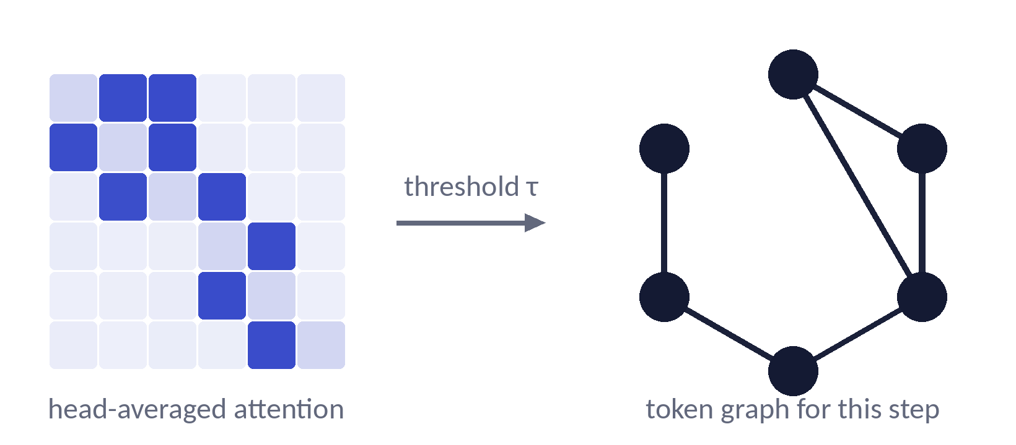
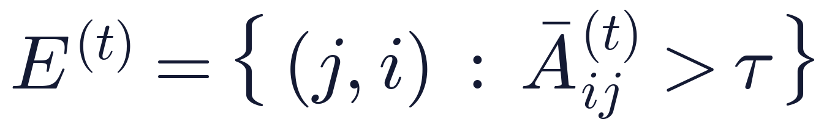
Key idea: read each denoising step as a token graph
Why attention?
1
Native. The only per-step, per-token-pair signal the model exposes. No metric or extra model to choose.
2
Free. Already computed in the forward pass. Building the graph is a single threshold.
3
On target. Bidirectional attention is how diffusion LLMs refine context, so its evolution is what we want to track.
An edge j → i when token i attends strongly to token j (head-averaged final-layer attention, τ = 0.05).
Notes:
Our key idea is to read every denoising step as a graph. Tokens are nodes, and we place an edge from token j to token i whenever i attends strongly to j in the head-averaged final-layer attention, using a threshold tau of 0.05. Why attention rather than, say, a nearest-neighbour graph over hidden states? It is the only per-step, per-pair signal the model exposes natively; it is already computed, so the graph costs one threshold; and bidirectional attention is precisely the mechanism diffusion models use to refine context, so its evolution is what we want to follow.

Slide 6
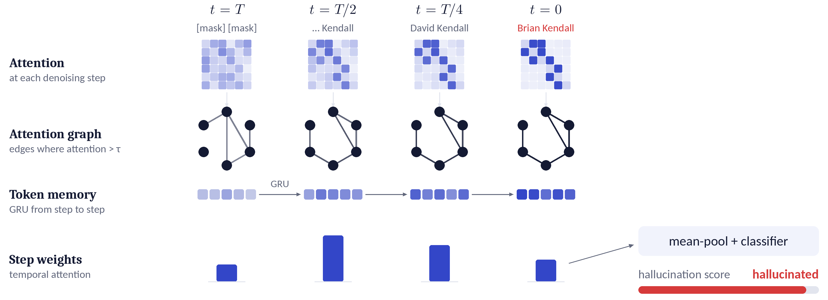
TDGNet tracks how token interactions evolve
Keyframes t ∈ {T, T/2, T/4, 0}. Node features: projected final-layer hidden states. Edge features: attention weights.
Notes:
Here is the full pipeline. At each keyframe of the trajectory we build the attention graph. Node features are the projected hidden states and edge features are the attention weights. TDGNet passes messages within each graph, keeps a memory for every token that is updated from step to step, and finally learns which steps matter most before scoring the whole answer. In this example, the answer Brian Kendall is flagged as hallucinated.

Slide 7
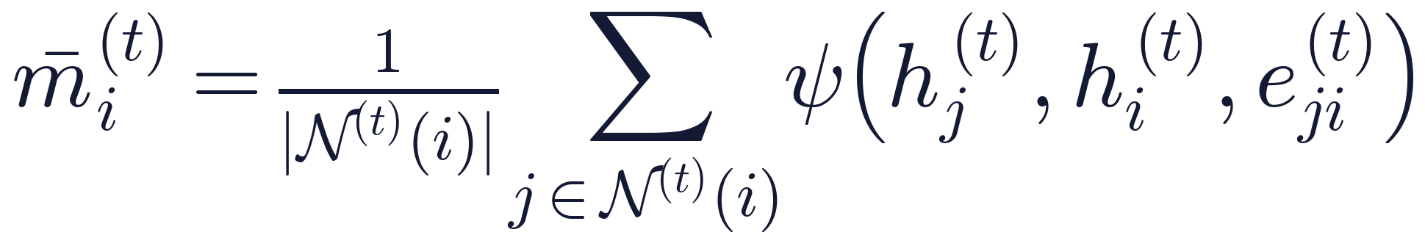
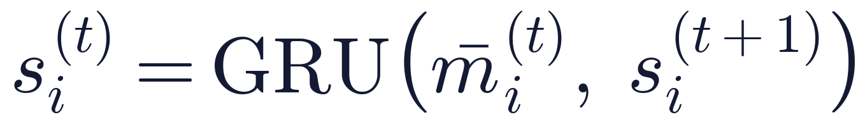
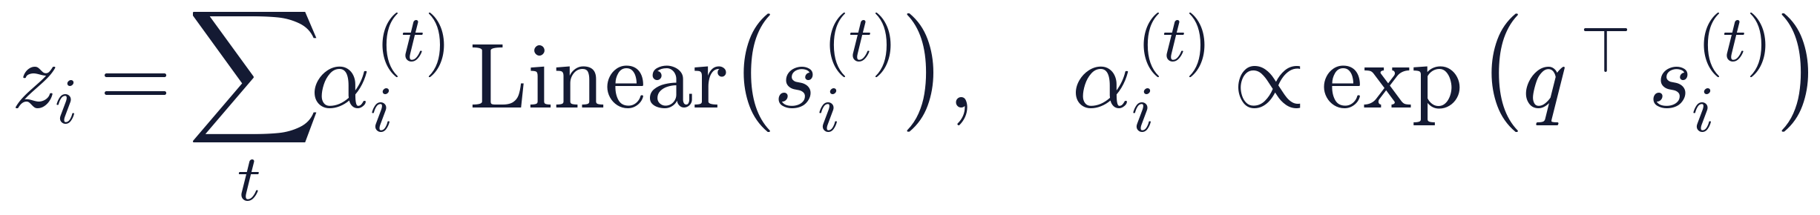
Three stages, trained end-to-end
Spatial aggregation
1
Message passing over each step’s attention neighbourhood.
Temporal memory
2
A GRU carries each token’s evidence from step to step.
Temporal attention readout
3
A learned query weighs the most informative steps per token.
Response level: mean-pool the token embeddings, then a binary classifier (cross-entropy). Token level: classify each embedding directly.
Notes:
In more detail, there are three stages, all trained end-to-end. First, spatial aggregation: an MLP-based message-passing step summarises each token's attention neighbourhood at that step. Second, temporal memory: a GRU updates a persistent memory for every token as we move from noise to the final answer. Third, a temporal attention readout: a learned query decides which steps are most informative for each token. For response-level detection we mean-pool and classify; for token-level localisation we classify each token embedding directly.

Slide 8




Experimental setup
Models
Datasets
LLaDA-8B-Instruct and Dream-7B-Instruct (main). LLaDA 1.5 (8B) and LLaDA 2.1-mini (16B MoE) for generalisation.
Math, CommonsenseQA, HotpotQA, TriviaQA. Natural Questions and TriviaQA for token-level localisation.
Baselines
Protocol
Output-based: Semantic Entropy, Lexical Similarity, LN-Entropy, Perplexity. Latent-based: EigenScore, TSV, CCS. Graph-based: CHARM.
AUROC. 1,500 / 300 / 300 splits per dataset. 32 generated tokens, 16 denoising steps, τ = 0.05.
Notes:
We evaluate on two main diffusion models, LLaDA-8B and Dream-7B, and test generalisation on LLaDA 1.5 and the 16-billion-parameter mixture-of-experts LLaDA 2.1-mini. We use four QA benchmarks for response-level detection, plus Natural Questions and TriviaQA for token-level localisation. Baselines cover output-based, latent-based and graph-based detectors. We report AUROC, with fixed 1500, 300, 300 splits, 32 generated tokens and 16 denoising steps.

Slide 9
TDGNet is best on average for both models
+0.03 over Semantic Entropy
+0.04 over Lexical Similarity
Average AUROC over Math, CSQA, HotpotQA and TriviaQA. Axes start at 0.5 (chance). Per-dataset results in the backup slides.
Notes:
Here are the main results. On LLaDA-8B, TDGNet reaches an average AUROC of 0.68, ahead of semantic entropy at 0.65. On Dream-7B it reaches 0.73 against 0.69 for lexical similarity. Note that the strongest baseline changes from model to model, while TDGNet is best on average on both, and it is best or tied on every individual benchmark in the full table. Note the axes start at chance, 0.5.

Slide 10
It also localises hallucinated tokens
0.87
token-level AUROC on Natural Questions
0.85
on TriviaQA, ahead of the static-graph CHARM (0.84 and 0.83)
Notes:
Because TDGNet produces an embedding per token, the same model can localise which tokens are hallucinated. Standard uncertainty scores reach about 0.7 AUROC, because a sequence-level score diluted across tokens hides local errors. TDGNet reaches 0.87 on Natural Questions and 0.85 on TriviaQA, ahead of the static-graph baseline CHARM, which shows that the temporal memory refines where the error is, not just whether there is one.

Slide 11
Both time and structure matter
Static graphs at any single step trail the full trajectory.
Without edges, AUROC falls to 0.40–0.49, near chance.
LLaDA-8B. Left: static-graph detector at one step (average AUROC). Right: TDGNet with the attention edges removed.
Notes:
Two ablations explain where the gains come from. On the left, a static graph detector applied at a single step peaks in the middle of the trajectory, at 0.66, and is weaker at both the start and the end; using all steps gives 0.68. So the evidence is distributed, not localised at one step. On the right, removing the edges reduces TDGNet to a per-token classifier, and performance collapses to near chance on every dataset. Both the temporal and the relational parts are needed.

Slide 12
It generalises across models and datasets
Zero-shot across datasets
0.55–0.62
AUROC for TDGNet on all but one source–target pair, while CCS drops to 0.50–0.54 on distant pairs.
HotpotQA is the strongest source (0.59–0.62), suggesting multi-hop patterns transfer.
Notes:
TDGNet is not tied to one model. On LLaDA 1.5 it reaches 0.76 and on the 16B mixture-of-experts LLaDA 2.1-mini it reaches 0.74, ahead of all baselines on both, even though the latter uses block-local attention. It also transfers zero-shot across datasets: 0.55 to 0.62 AUROC on all but one source-target pair, while latent probes like CCS fall to near chance. Training on HotpotQA transfers best, which suggests the hallucination signatures are partly task-agnostic.

Slide 13



Near single-pass cost
4.8×
faster than Semantic Entropy
~160 ms
extra per query, about 4.4% of generation time
1
generation per query instead of 5
Notes:
TDGNet is also cheap. Sampling-based methods need five generations per query, so they take around 2100 seconds per 100 queries on LLaDA-8B. TDGNet runs on a single denoising trajectory and reuses attention the model already computes, so it adds about 160 milliseconds per query, roughly 4 percent of generation time, and is about 4.8 times faster than semantic entropy, close to single-pass baselines like perplexity.

Slide 14
Takeaways
Factuality is a trajectory property
Limitations
In diffusion LLMs, hallucinations appear, drift and self-correct across denoising steps.
QA-style benchmarks only: reliable factuality labels for long-form generation are scarce.
Current open diffusion LLMs are unstable on long outputs, which blurs hallucination and fluency failures.
Attention graphs over time capture it
Message passing, per-token memory and temporal attention, from a single generation.
Consistent gains
Best average AUROC on two models, token-level localisation, and transfer to new architectures.
Notes:
To summarise: in diffusion language models, factuality is a property of the trajectory. TDGNet captures it by learning over attention graphs across denoising steps, with per-token memory and temporal attention, all from one generation. It gives the best average AUROC on both main models, localises hallucinated tokens, and transfers to new architectures. Our study is limited to QA-style benchmarks, where labels are reliable, and current open diffusion models are still unstable on long outputs; extending this to long-form generation is a natural next step.

Slide 15
Thank you
Questions welcome
Paper arxiv.org/abs/2602.08048
Project arshiahemmat.github.io/tdgnet
Notes:
Thank you. The paper and project page are linked here, and I am happy to take questions.

Slide 16
Backup: per-dataset response-level AUROC
LLaDA-8B-Instruct
Dream-7B-Instruct
Method | Math | CSQA | Hotpot | Trivia | Avg
Semantic Entropy | 0.68 | 0.64 | 0.61 | 0.66 | 0.65
Lexical Similarity | 0.51 | 0.53 | 0.54 | 0.54 | 0.53
LN-Entropy | 0.70 | 0.59 | 0.55 | 0.55 | 0.60
Perplexity | 0.67 | 0.60 | 0.51 | 0.54 | 0.58
EigenScore | 0.56 | 0.54 | 0.56 | 0.59 | 0.56
TSV | 0.72 | 0.61 | 0.55 | 0.50 | 0.60
CCS | 0.59 | 0.56 | 0.60 | 0.54 | 0.57
TDGNet | 0.72 | 0.65 | 0.64 | 0.72 | 0.68
Method | Math | CSQA | Hotpot | Trivia | Avg
Semantic Entropy | 0.59 | 0.50 | 0.68 | 0.69 | 0.62
Lexical Similarity | 0.71 | 0.68 | 0.71 | 0.67 | 0.69
LN-Entropy | 0.57 | 0.59 | 0.52 | 0.53 | 0.55
Perplexity | 0.52 | 0.57 | 0.51 | 0.54 | 0.54
EigenScore | 0.68 | 0.55 | 0.63 | 0.70 | 0.64
TSV | 0.68 | 0.71 | 0.43 | 0.50 | 0.58
CCS | 0.59 | 0.56 | 0.64 | 0.60 | 0.60
TDGNet | 0.72 | 0.72 | 0.74 | 0.74 | 0.73
Table 1 of the paper. TDGNet is best or tied-best on every benchmark for both models.
Notes:
Backup: the full Table 1 with per-dataset AUROC for both models.

Slide 17
Backup: comparison with concurrent TraceDet
Method | Math | CSQA | HotpotQA | TriviaQA | Avg
TraceDet (w/o masking)† | 0.74 | 0.67 | 0.59 | 0.71 | 0.68
TDGNet (τ = 0.05) | 0.72 | 0.65 | 0.64 | 0.72 | 0.68
TDGNet (τ = 0.03) | 0.73 | 0.61 | 0.62 | 0.80 | 0.69
Similar average AUROC. TDGNet is stronger on HotpotQA (+0.05) and TriviaQA (+0.09 at τ = 0.03); TraceDet is stronger on Math and CSQA.
TDGNet additionally supports token-level localisation, which entropy-trace methods do not.
†Reproduced from the specification in Chang et al. (2026); official code unreleased at the time of writing. LLaDA-8B.
Notes:
If asked about TraceDet: it is concurrent work using token-level entropy traces. In our faithful reproduction the averages are similar; TDGNet is stronger on the reasoning-heavy HotpotQA and TriviaQA, TraceDet on Math and CSQA, and TDGNet additionally localises hallucinated tokens.

Slide 18
Backup: sensitivity to the edge threshold τ
Threshold | Math | CSQA | HotpotQA | TriviaQA | Avg
τ = 0.03 | 0.73 | 0.61 | 0.62 | 0.80 | 0.69
τ = 0.05 (default) | 0.72 | 0.65 | 0.64 | 0.72 | 0.68
Robust for τ between 0.03 and 0.05 (average differs by 0.01). A lower τ keeps more edges and helps recall-oriented TriviaQA.
At τ = 0.07, over 97% of edges are removed and performance collapses to chance.
LLaDA-8B, response-level AUROC.
Notes:
If asked about the threshold: results are stable between 0.03 and 0.05, and we use 0.05 everywhere for consistency. Too aggressive a threshold, 0.07, removes almost all edges and the detector fails, consistent with the no-edges ablation.

